Slide 1
Chapter 6
Requirements Engineering Process

Slide 2
Requirements Engineering Processes
Processes used to discover, analyse and validate system requirements

Slide 3
Objectives
To describe the principal requirements engineering activities
To introduce techniques for requirements elicitation and analysis
To describe requirements validation
To discuss the role of requirements management in support of other requirements engineering processes

Slide 4
Topics covered
Feasibility studies
Requirements elicitation and analysis
Requirements validation
Requirements management

Slide 5
Requirements engineering processes
The processes used for RE vary widely depending on the application domain, the people involved and the organisation developing the requirements
However, there are a number of generic activities common to all processes
  Requirements elicitation
  Requirements analysis
  Requirements validation
  Requirements management

Slide 6
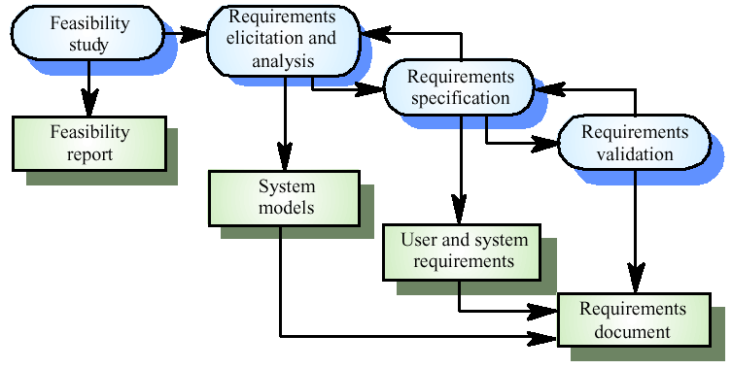
The requirements engineering process

Slide 7
Feasibility studies
A feasibility study decides whether or not the proposed system is worthwhile
A short focused study that checks
  If the system contributes to organisational objectives
  If the system can be engineered using current technology and within budget
  If the system can be integrated with other systems that are used

Slide 8
Feasibility study implementation
Based on information assessment (what is required), information collection and report writing
Questions for people in the organisation
  What if the system wasn’t implemented?
  What are current process problems?
  How will the proposed system help?
  What will be the integration problems?
  Is new technology needed? What skills?
  What facilities must be supported by the proposed system?

Slide 9
Elicitation and analysis
Sometimes called requirements elicitation or requirements discovery
Involves technical staff working with customers to find out about the application domain, the services that the system should provide and the system’s operational constraints
May involve end-users, managers, engineers involved in maintenance, domain experts, trade unions, etc. These are called stakeholders

Slide 10
Problems of requirements analysis
Stakeholders don’t know what they really want
Stakeholders express requirements in their own terms
Different stakeholders may have conflicting requirements
Organisational and political factors may influence the system requirements
The requirements change during the analysis process. New stakeholders may emerge and the business environment change

Slide 11
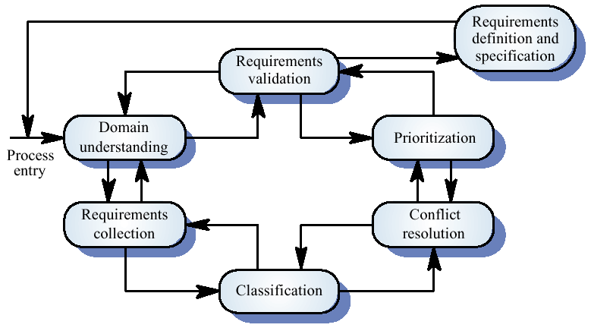
The requirements analysis process

Slide 12
Process activities
Domain understanding
Requirements collection
Classification
Conflict resolution
Prioritisation
Requirements checking

Slide 13
System models
Different models may be produced during the requirements analysis activity
Requirements analysis may involve three structuring activities which result in these different models
  Partitioning. Identifies the structural (part-of) relationships between entities
  Abstraction. Identifies generalities among entities
  Projection. Identifies different ways of looking at a problem
System models covered in Chapter 7

Slide 14
Viewpoint-oriented elicitation
Stakeholders represent different ways of looking at a problem or problem viewpoints
This multi-perspective analysis is important as there is no single correct way to analyse system requirements

Slide 15
Banking ATM system
The example used here is an auto-teller system which provides some automated banking services
I use a very simplified system which offers some services to customers of the bank who own the system and a narrower range of services to other customers
Services include cash withdrawal, message passing (send a message to request a service), ordering a statement and transferring funds

Slide 16
Autoteller viewpoints
Bank customers
Representatives of other banks
Hardware and software maintenance engineers
Marketing department
Bank managers and counter staff
Database administrators and security staff
Communications engineers
Personnel department

Slide 17
Types of viewpoint
Data sources or sinks
  Viewpoints are responsible for producing or consuming data. Analysis involves checking that data is produced and consumed and that assumptions about the source and sink of data are valid
Representation frameworks
  Viewpoints represent particular types of system model. These may be compared to discover requirements that would be missed using a single representation. Particularly suitable for real-time systems
Receivers of services
  Viewpoints are external to the system and receive services from it. Most suited to interactive systems

Slide 18
External viewpoints
Natural to think of end-users as receivers of system services
Viewpoints are a natural way to structure requirements elicitation
It is relatively easy to decide if a viewpoint is valid
Viewpoints and services may be sued to structure non-functional requirements

Slide 19
Method-based analysis
Widely used approach to requirements analysis. Depends on the application of a structured method to understand the system
Methods have different emphases. Some are designed for requirements elicitation, others are close to design methods
A viewpoint-oriented method (VORD) is used as an example here. It also illustrates the use of viewpoints

Slide 20
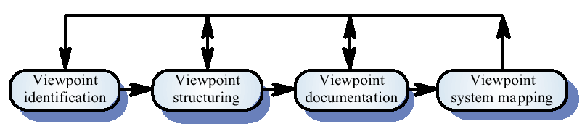
The VORD method

Slide 21
VORD process model
Viewpoint identification
  Discover viewpoints which receive system services and identify the services provided to each viewpoint
Viewpoint structuring
  Group related viewpoints into a hierarchy. Common services are provided at higher-levels in the hierarchy
Viewpoint documentation
  Refine the description of the identified viewpoints and services
Viewpoint-system mapping
  Transform the analysis to an object-oriented design

Slide 22
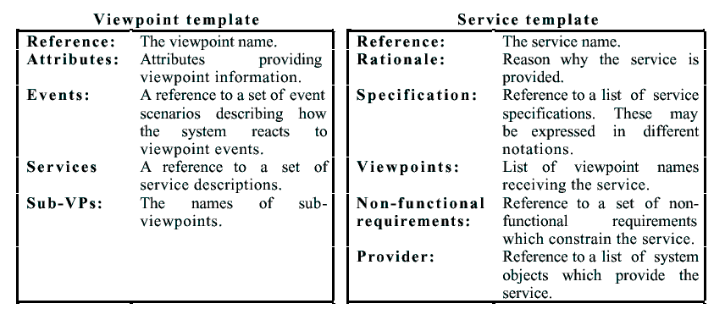
VORD standard forms

Slide 23
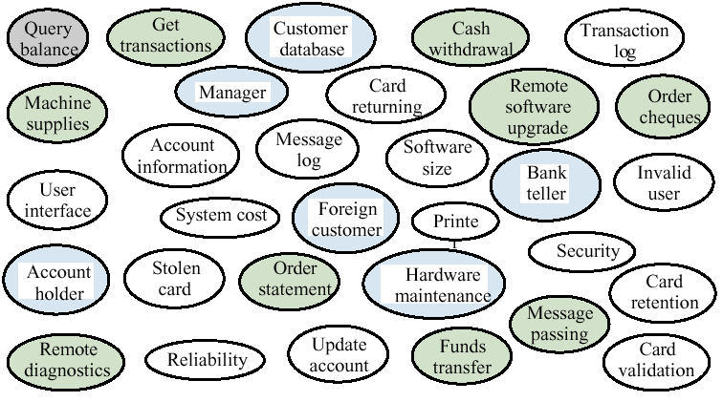
Viewpoint identification

Slide 24
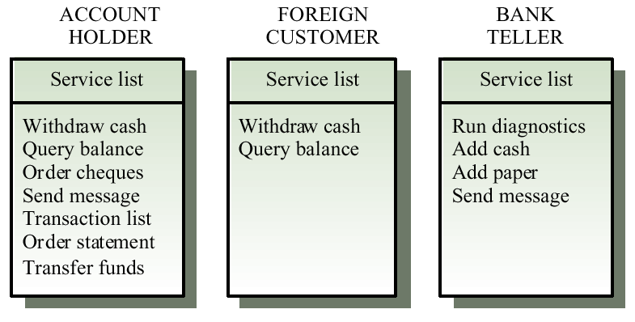
Viewpoint service information

Slide 25
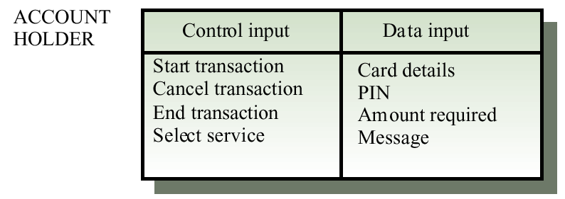
Viewpoint data/control

Slide 26
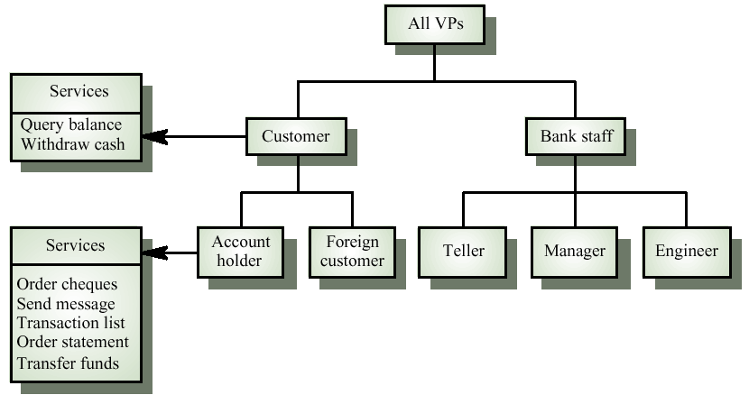
Viewpoint hierarchy

Slide 27
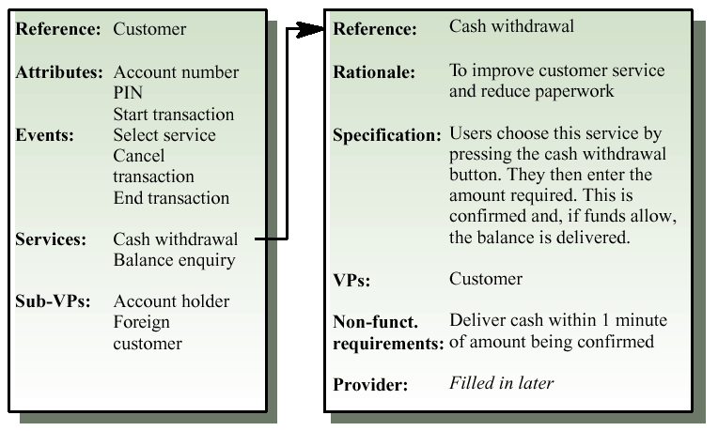
Customer/cash withdrawal templates

Slide 28
Scenarios
Scenarios are descriptions of how a system is used in practice
They are helpful in requirements elicitation as people can relate to these more readily than abstract statement of what they require from a system
Scenarios are particularly useful for adding detail to an outline requirements description

Slide 29
Scenario descriptions
System state at the beginning of the scenario
Normal flow of events in the scenario
What can go wrong and how this is handled
Other concurrent activities
System state on completion of the scenario

Slide 30
Event scenarios
Event scenarios may be used to describe how a system responds to the occurrence of some particular event such as ‘start transaction’
VORD includes a diagrammatic convention for event scenarios.
  Data provided and delivered
  Control information
  Exception processing
  The next expected event

Slide 31
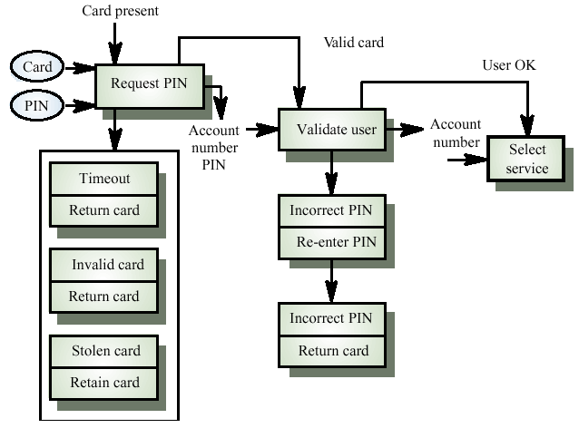
Event scenario - start transaction

Slide 32
Notation for data and control analysis
Ellipses. data provided from or delivered to a viewpoint
Control information enters and leaves at the top of each box
Data leaves from the right of each box
Exceptions are shown at the bottom of each box
Name of next event is in box with thick edges

Slide 33
Exception description
Most methods do not include facilities for describing exceptions
In this example, exceptions are
  Timeout. Customer fails to enter a PIN within the allowed time limit
  Invalid card. The card is not recognised and is returned
  Stolen card. The card has been registered as stolen and is retained by the machine

Slide 34
Use cases
Use-cases are a scenario based technique in the UML which identify the actors in an interaction and which describe the interaction itself
A set of use cases should describe all possible interactions with the system
Sequence diagrams may be used to add detail to use-cases by showing the sequence of event processing in the system

Slide 35
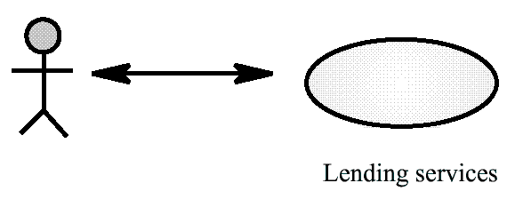
Lending use-case

Slide 36
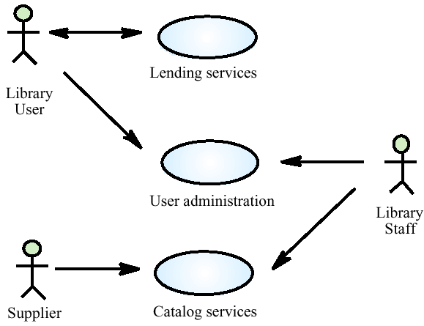
Library use-cases

Slide 37
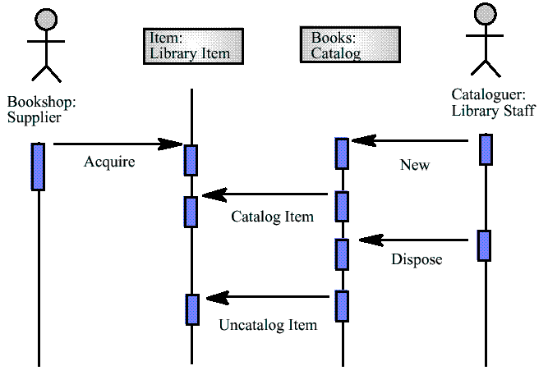
Catalogue management

Slide 38
Social and organisational factors
Software systems are used in a social and organisational context. This can influence or even dominate the system requirements
Social and organisational factors are not a single viewpoint but are influences on all viewpoints
Good analysts must be sensitive to these factors but currently no systematic way to tackle their analysis

Slide 39
Example
Consider a system which allows senior management to access information without going through middle managers
  Managerial status. Senior managers may feel that they are too important to use a keyboard. This may limit the type of system interface used
  Managerial responsibilities. Managers may have no uninterrupted time where they can learn to use the system
  Organisational resistance. Middle managers who will be made redundant may deliberately provide misleading or incomplete information so that the system will fail

Slide 40
Ethnography
A social scientists spends a considerable time observing and analysing how people actually work
People do not have to explain or articulate their work
Social and organisational factors of importance may be observed
Ethnographic studies have shown that work is usually richer and more complex than suggested by simple system models

Slide 41
Focused ethnography
Developed in a project studying the air traffic control process
Combines ethnography with prototyping
Prototype development results in unanswered questions which focus the ethnographic analysis
Problem with ethnography is that it studies existing practices which may have some historical basis which is no longer relevant

Slide 42
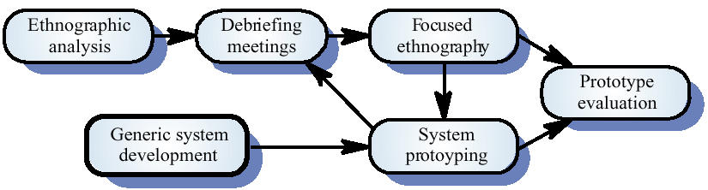
Ethnography and prototyping

Slide 43
Scope of ethnography
Requirements that are derived from the way that people actually work rather than the way I which process definitions suggest that they ought to work
Requirements that are derived from cooperation and awareness of other people’s activities

Slide 44
Requirements validation
Concerned with demonstrating that the requirements define the system that the customer really wants
Requirements error costs are high so validation is very important
  Fixing a requirements error after delivery may cost up to 100 times the cost of fixing an implementation error

Slide 45
Requirements checking
Validity. Does the system provide the functions which best support the customer’s needs?
Consistency. Are there any requirements conflicts?
Completeness. Are all functions required by the customer included?
Realism. Can the requirements be implemented given available budget and technology
Verifiability. Can the requirements be checked?

Slide 46
Requirements validation techniques
Requirements reviews
  Systematic manual analysis of the requirements
Prototyping
  Using an executable model of the system to check requirements. Covered in Chapter 8
Test-case generation
  Developing tests for requirements to check testability
Automated consistency analysis
  Checking the consistency of a structured requirements description

Slide 47
Requirements reviews
Regular reviews should be held while the requirements definition is being formulated
Both client and contractor staff should be involved in reviews
Reviews may be formal (with completed documents) or informal. Good communications between developers, customers and users can resolve problems at an early stage

Slide 48
Review checks
Verifiability. Is the requirement realistically testable?
Comprehensibility. Is the requirement properly understood?
Traceability. Is the origin of the requirement clearly stated?
Adaptability. Can the requirement be changed without a large impact on other requirements?

Slide 49
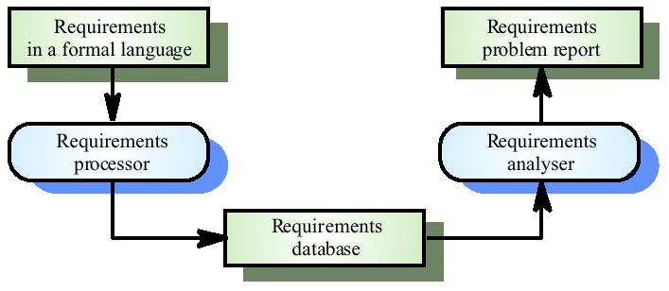
Automated consistency checking

Slide 50
Requirements management
Requirements management is the process of managing changing requirements during the requirements engineering process and system development
Requirements are inevitably incomplete and inconsistent
  New requirements emerge during the process as business needs change and a better understanding of the system is developed
  Different viewpoints have different requirements and these are often contradictory

Slide 51
Requirements change
The priority of requirements from different viewpoints changes during the development process
System customers may specify requirements from a business perspective that conflict with end-user requirements
The business and technical environment of the system changes during its development

Slide 52
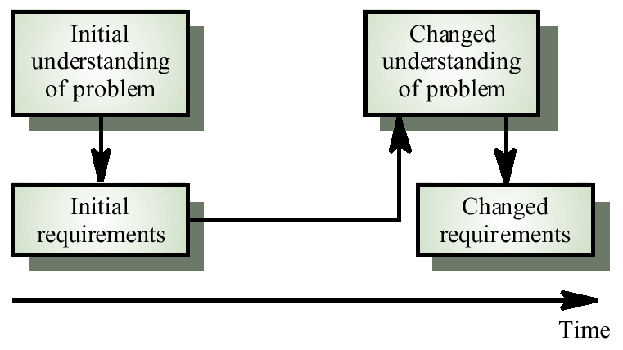
Requirements evolution

Slide 53
Enduring and volatile requirements
Enduring requirements. Stable requirements derived from the core activity of the customer organisation. E.g. a hospital will always have doctors, nurses, etc. May be derived from domain models
Volatile requirements. Requirements which change during development or when the system is in use. In a hospital, requirements derived from health-care policy

Slide 54
Classification of requirements
Mutable requirements
  Requirements that change due to the system’s environment
Emergent requirements
  Requirements that emerge as understanding of the system develops
Consequential requirements
  Requirements that result from the introduction of the computer system
Compatibility requirements
  Requirements that depend on other systems or organisational processes

Slide 55
Requirements management planning
During the requirements engineering process, you have to plan:
  Requirements identification
    How requirements are individually identified
  A change management process
    The process followed when analysing a requirements change
  Traceability policies
    The amount of information about requirements relationships that is maintained
  CASE tool support
    The tool support required to help manage requirements change

Slide 56
Traceability
Traceability is concerned with the relationships between requirements, their sources and the system design
Source traceability
  Links from requirements to stakeholders who proposed these requirements
Requirements traceability
  Links between dependent requirements
Design traceability
  Links from the requirements to the design

Slide 57
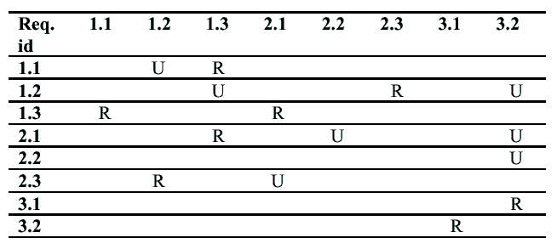
A traceability matrix

Slide 58
CASE tool support
Requirements storage
  Requirements should be managed in a secure, managed data store
Change management
  The process of change management is a workflow process whose stages can be defined and information flow between these stages partially automated
Traceability management
  Automated retrieval of the links between requirements

Slide 59
Requirements change management
Should apply to all proposed changes to the requirements
Principal stages
  Problem analysis. Discuss requirements problem and propose change
  Change analysis and costing. Assess effects of change on other requirements
  Change implementation. Modify requirements document and other documents to reflect change

Slide 60
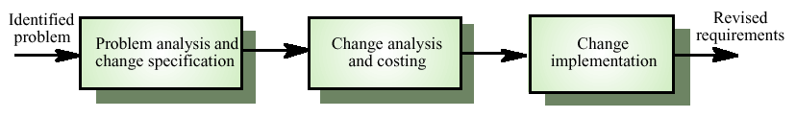
Requirements change management

Slide 61
Key points
The requirements engineering process includes a feasibility study, requirements elicitation and analysis, requirements specification and requirements management
Requirements analysis is iterative involving domain understanding, requirements collection, classification, structuring, prioritisation and validation
Systems have multiple stakeholders with different requirements

Slide 62
Key points
Social and organisation factors influence system requirements
Requirements validation is concerned with checks for validity, consistency, completeness, realism and verifiability
Business changes inevitably lead to changing requirements
Requirements management includes planning and change management

